Slide 1

amazon

Slide 2
01
Introduction
02
Exploratory Data Analysis
03
Classification
Contents
04
Clustering
05
Summarize
06
Major Obstacle
07
Deployment

Slide 3

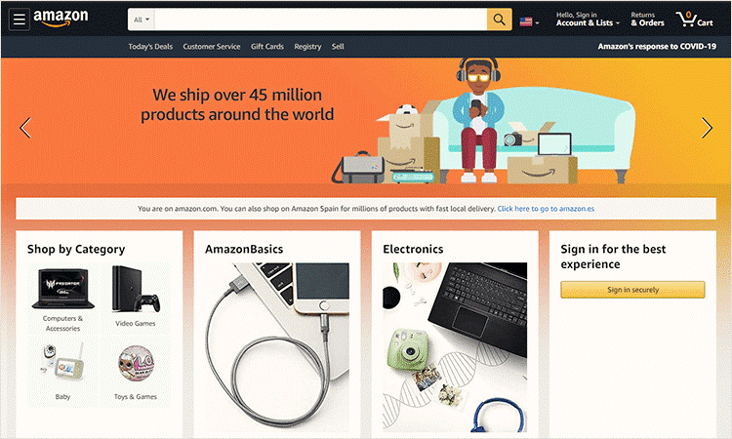
Introduction
With the growing number of online product reviews, making sense of customer feedback has become a real challenge. Manually analyzing thousands of reviews is time-consuming and inefficient.
This project aims to solve that problem by building an intelligent review analysis system using Natural Language Processing (NLP) techniques.
We used a dataset of over 28,000 Amazon product reviews and focused on three main goals:
Classifying reviews into positive, negative, or neutral sentiments.
Clustering products into simplified meta-categories.
Summarizing reviews into recommendation-style articles using generative AI.
The final result is an interactive web application that helps users gain quick, valuable insights from massive review data.

Slide 4

Exploratory Data Analysis
This dataset contains over 28,000 Amazon product reviews from Datafiniti's Product Database, collected between February and April 2019. It includes reviews for products such as the Kindle and Fire TV Stick.
Key Characteristics:
The data is flattened to simplify analysis.
Imbalanced ratings, with the majority of reviews being 4 or 5 stars.
Sentiment Mapping:
Negative -> 1–2 stars
Neutral -> 3 stars
Positive -> 4–5 stars
Key Features Used:
Reviews.text: The main review content (input for NLP models)
Reviews.title: Combined with text for deeper analysis
Reviews.rating: Determines sentiment class
Categories: Used to cluster products
Name: Identifies the product

Slide 5
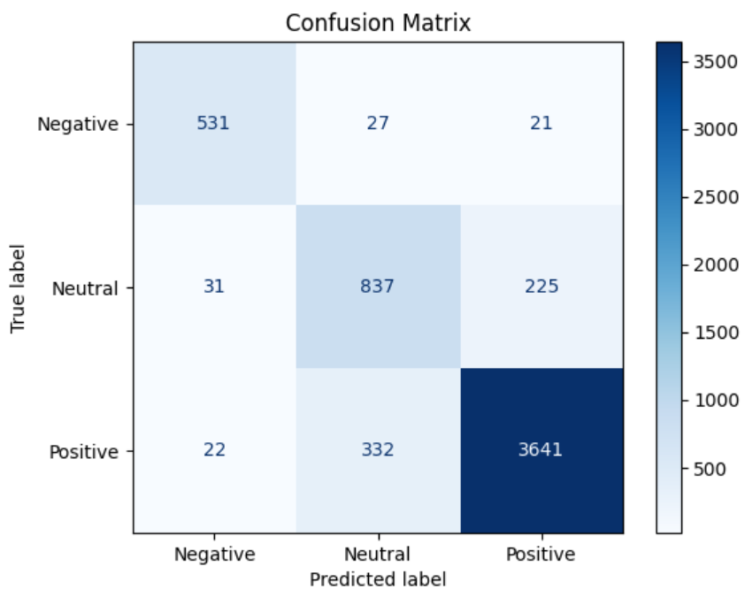
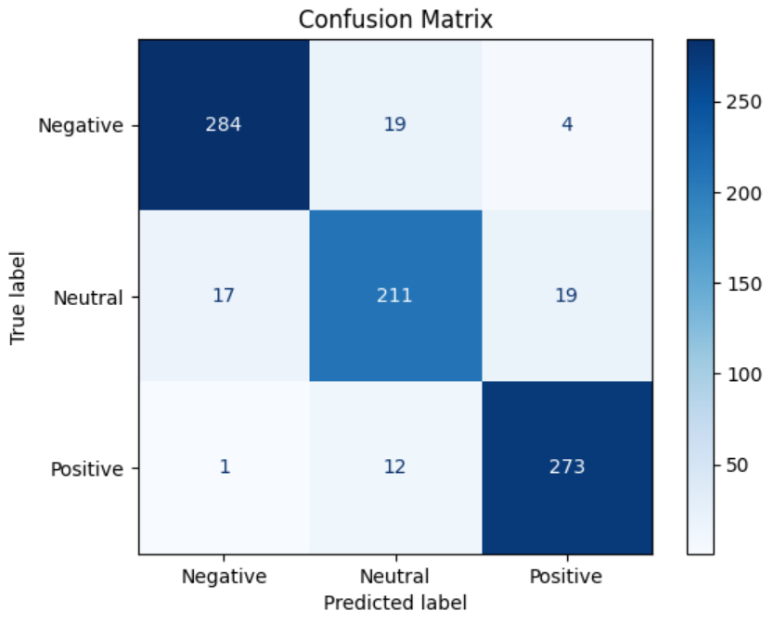
Handling Data Imbalance
Class Weights:
Data Resampling:
Initially, we applied class weights to penalize misclassifications in the Negative and Neutral classes. However, this approach did not produce optimal results in balancing the model's performance.
The more effective solution involved resampling the data. By combining and resampling the reviews, we were able to balance the distribution of sentiment classes. This method helped to reduce the bias towards the Positive class and ensured better performance

Slide 6
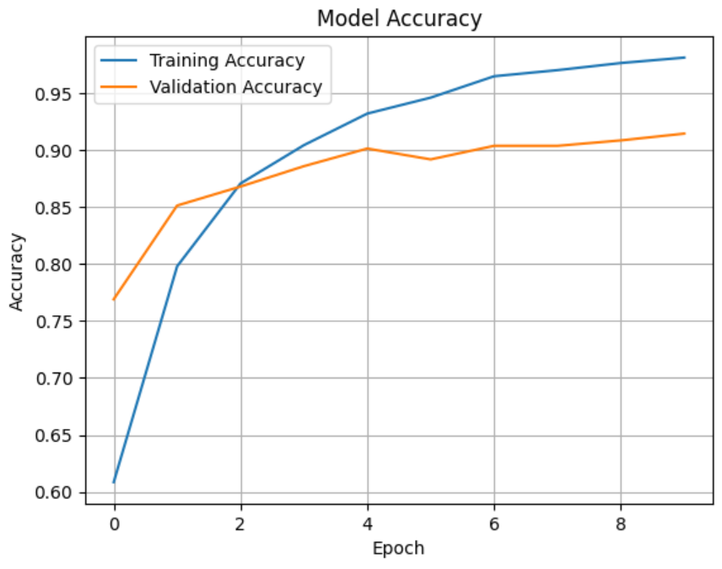
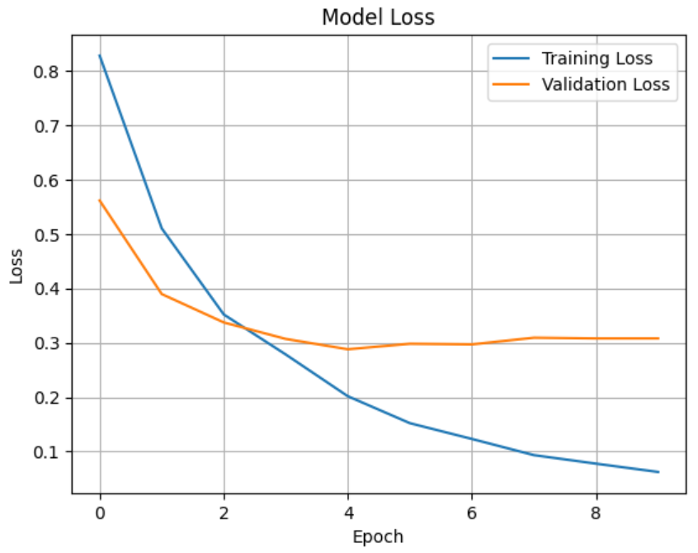
Classification
BERT is a language model from Google that understands words based on their full context, both before and after the word, allowing it to capture meanings accurately. It relies on the Transformer encoder and is pretrained on tasks like predicting missing words and sentence relationships. BERT is used in tasks like sentiment analysis, question answering, and text classification.
Key Steps:
Combined review text and title to provide better context.
Tokenized the text using BERT’s tokenizer.
Created TensorFlow datasets and batched the data for training.
Used a BERT classification model with 3 output labels and 30% dropout for regularization.
Trained the model over 10 epochs with appropriate optimizer and accuracy tracking.

Slide 7
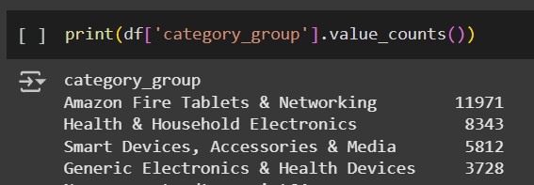
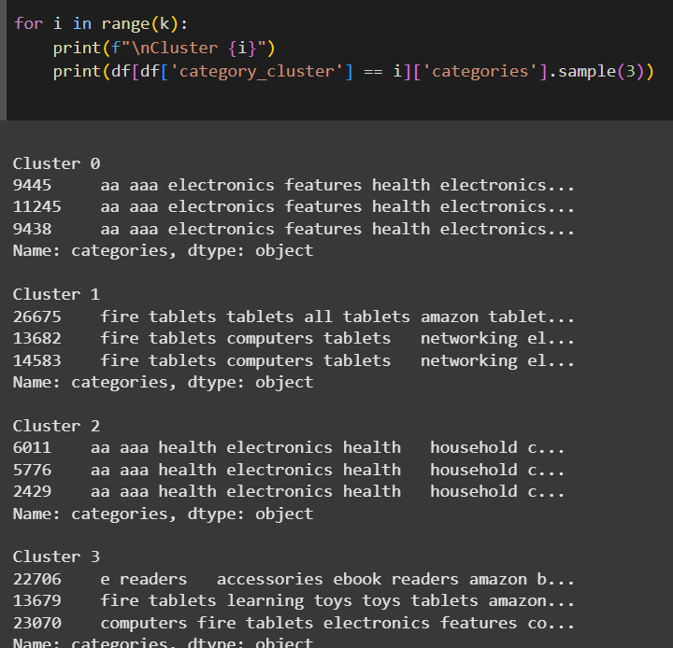
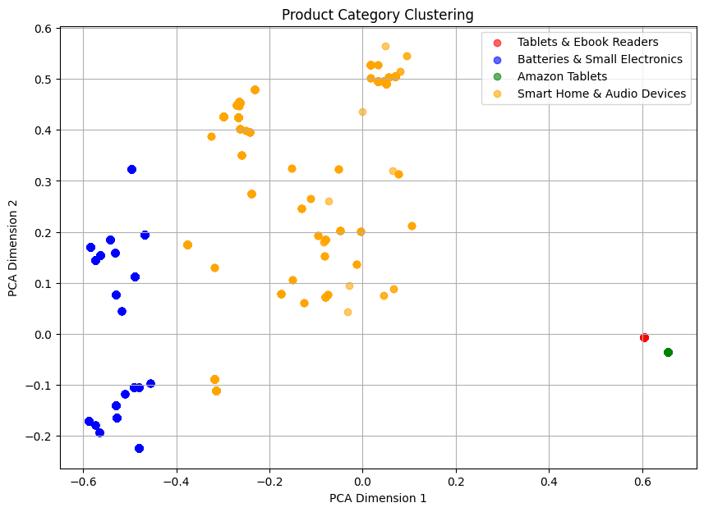
Clustering
KMeans Clustering is an unsupervised learning algorithm that groups data points into k clusters based on similarity. It assigns data points to the nearest centroid, updates centroids iteratively, and repeats until convergence. The result is useful for grouping similar items and identifying patterns in data.
Key Steps:
PCA: Reduce dimensions to 2D for easier visualization.
KMeans: Cluster data into 4 groups based on similarity.
Add Clusters: Add cluster results to the DataFrame.
Name Clusters: Assign descriptive names to each cluster.
Visualization: Display results in a 2D scatter plot.

Slide 8
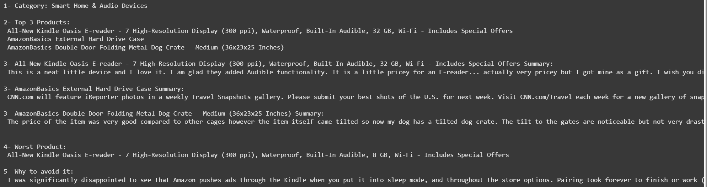
Summarize
Key Steps:
Filtering data by category: groups the data based on product categories.
Selecting top and worst products: identifies the top 3 products based on average sentiment and the worst product based on the lowest sentiment score.
Summarizing reviews: gathers and summarizes reviews for each product using the BART model from Hugging Face.
Generating articles: creates an article for each category, listing the top products, their reviews, and the worst product with reasons to avoid it.
BART is a powerful model developed by Facebook AI, combining Bidirectional Encoding (like BERT) and Autoregressive Decoding (like GPT). It processes text by understanding context in both directions and then generates text in a sequence.
It is trained on tasks like text summarization and text generation, where it learns to rebuild text by predicting missing or altered parts. This makes it effective for summarizing long texts and generating coherent summaries.

Slide 9
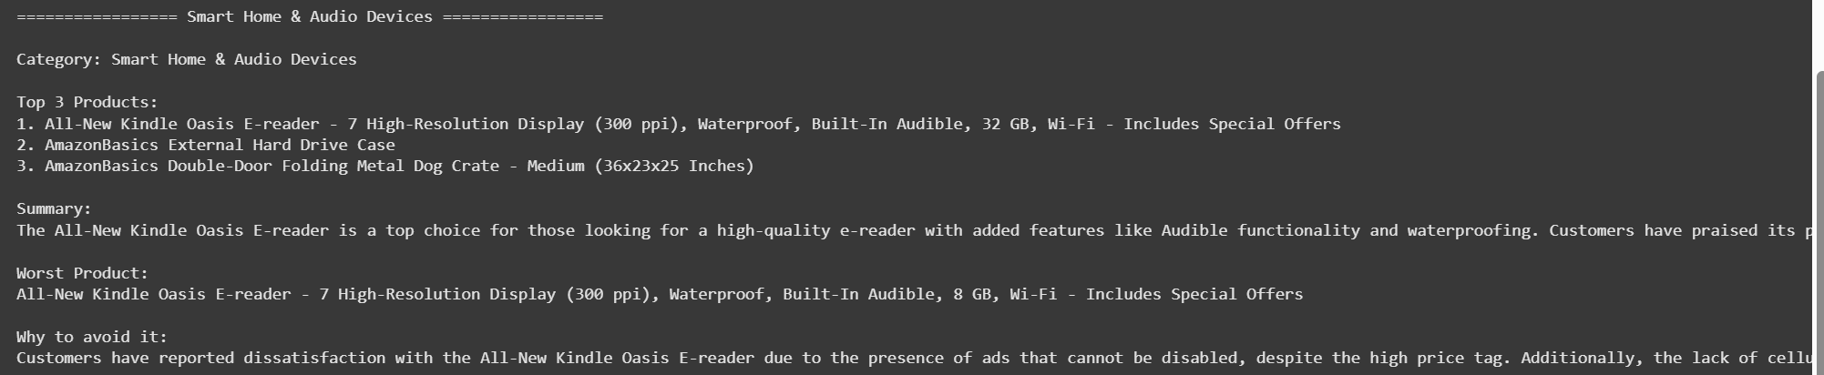
Summarize
Key Steps:
Load product reviews.
Find top 3 and worst product per category.
Collect sample reviews.
Create a prompt with product info.
Send it to GPT-3.5-Turbo.
Get and save the article summary.
GPT-3.5-Turbo is an advanced AI language model by OpenAI.
It generates human-like text based on user input.
It’s used for summarization, writing, answering questions, and analyzing text.
Fast, accurate, and more affordable than GPT-4, making it ideal for chatbots, content creation, and smart assistants.

Slide 10

Major Obstacle
ResourceExhaustedError
Imbalanced Data
occurs when the model exceeds the available memory (GPU/TPU/CPU). It’s common with large batch sizes or long sequence lengths, especially with models like BERT. This happens when the memory consumption, particularly in the Attention layers of the Transformer, is too high. It’s the same Out of Memory (OOM)
occurs when some classes are underrepresented compared to others in dataset. This can cause the model to be biased toward the majority class and perform poorly on the minority class. Common issues include misleading accuracy and poor generalization.

Slide 11
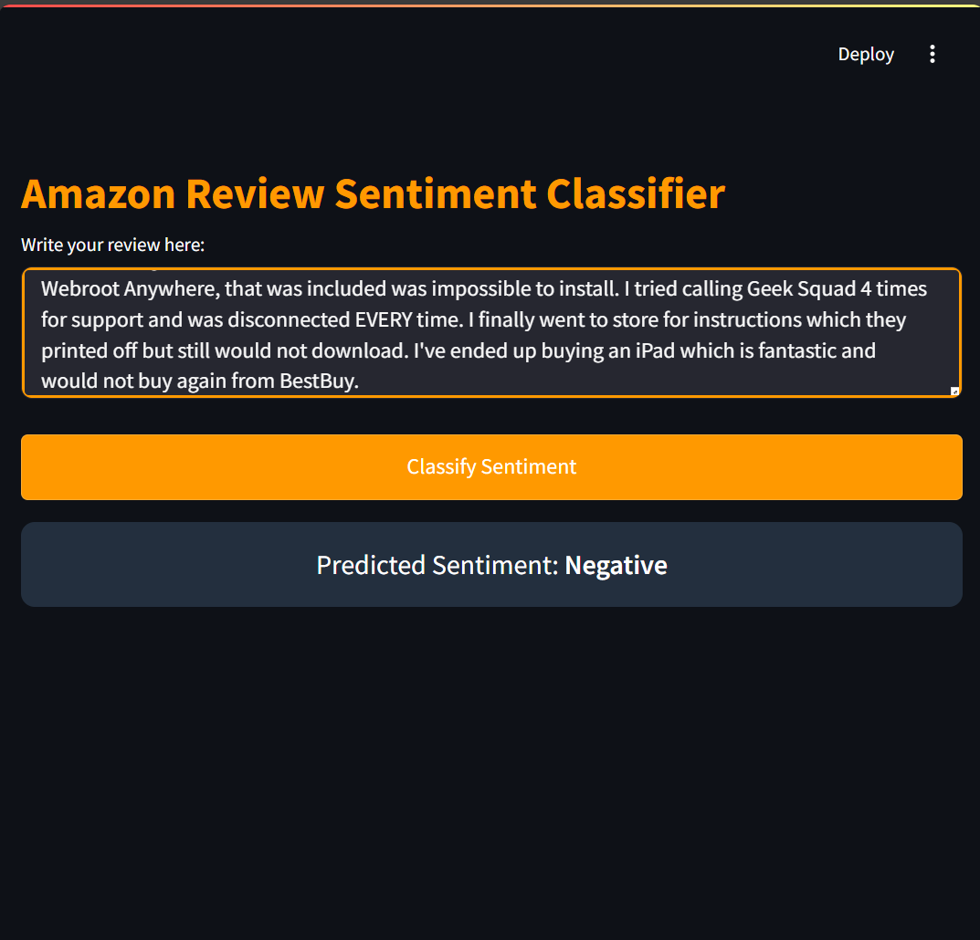
Deployment

Slide 12
thanks!

